Slide 1
Introduction to Machine Learning with Microsoft Azure ML Studio
Ishan Nangia

Slide 2
Agenda
Overview
Terminology
Categories of Machine Learning
Categories of Supervised Learning
Workflow of a Machine Learning Problem
Splitting a Dataset
Regression Metric
Hands-on ML studio
Quiz

Slide 3
Overview of Machine Learning

Slide 4
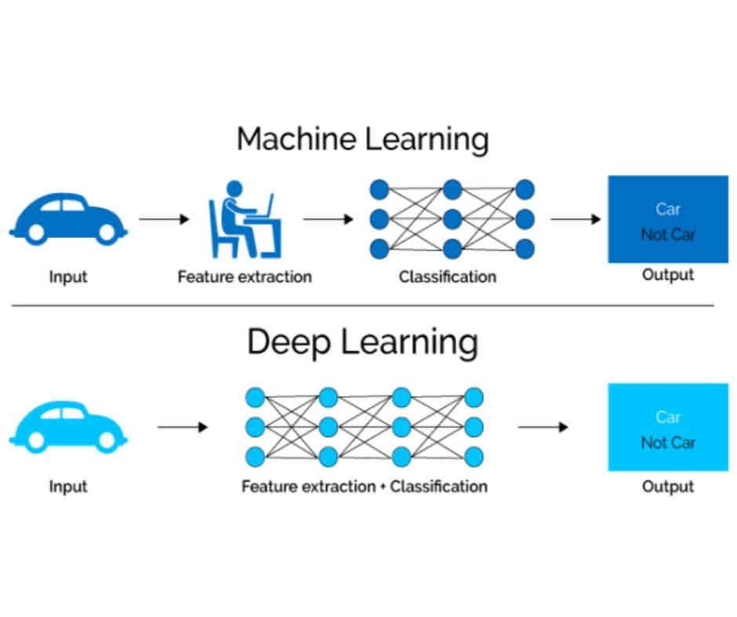
What is it?
Machine learning (ML) is the scientific study of algorithms and statistical models that computer systems use to perform a specific task without using explicit instructions, by relying on patterns and inference instead.

Slide 5
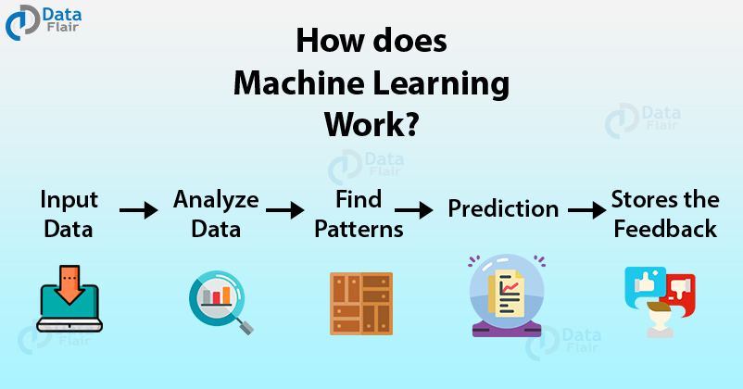
Umm…What is it again ?
Machine learning provides systems the ability to automatically learn and improve from experience without being explicitly programmed.
So basically, Machine learning studies algorithms for self-learning to get better at some task.

Slide 6
How does it work?
Imagine throwing a ball and hitting a target.
After the first attempt, you realize that you have put too much force.
After the second attempt, you realize you are closer to the target but you need to increase your throw angle, and so on…
We are learning from our previous outcomes

Slide 7
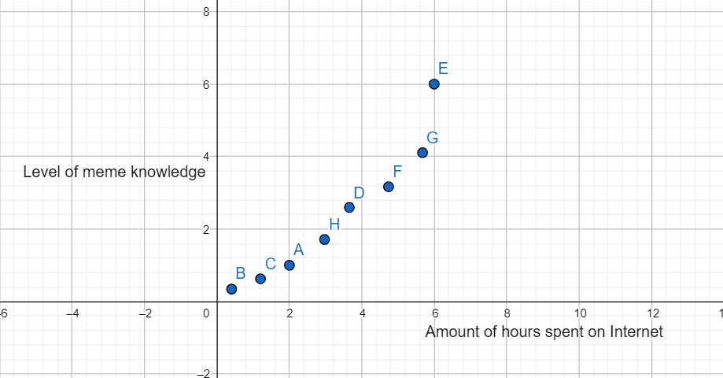
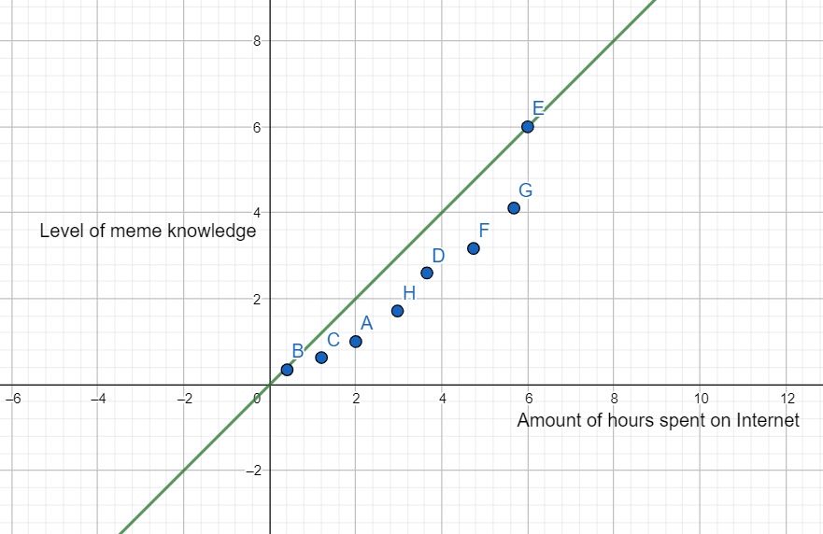
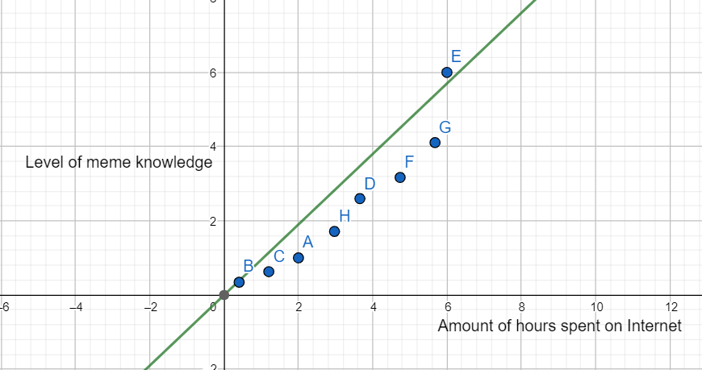
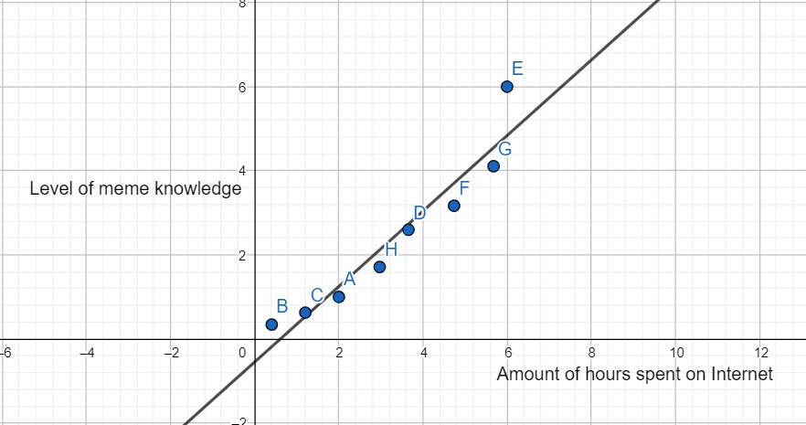

Slide 8
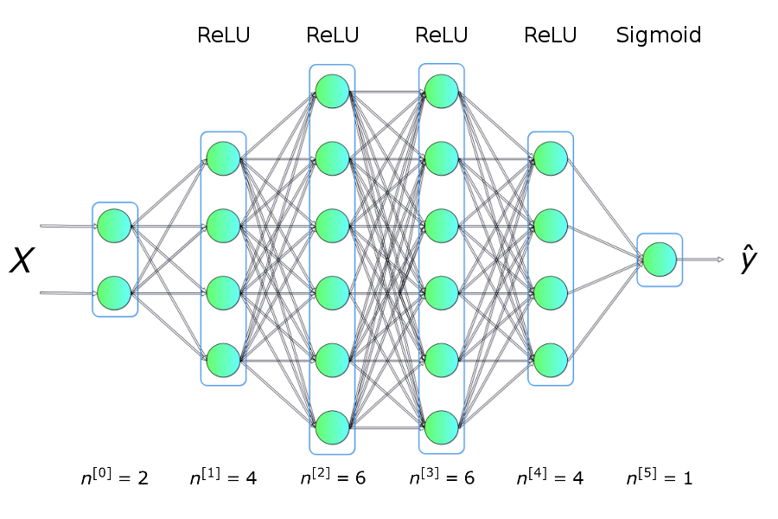
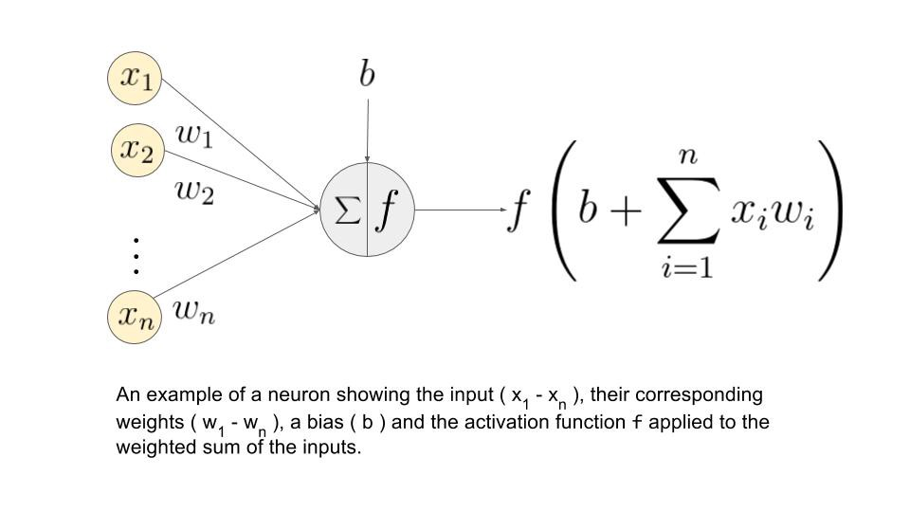
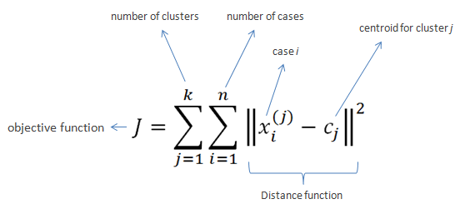
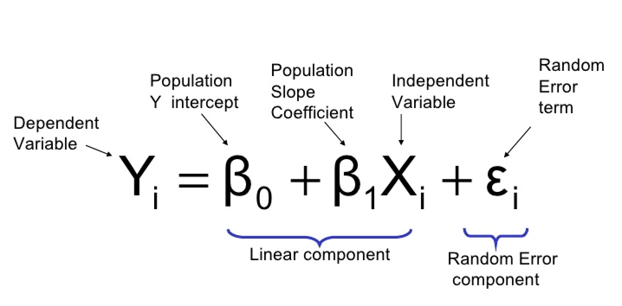
Some Models

Slide 9
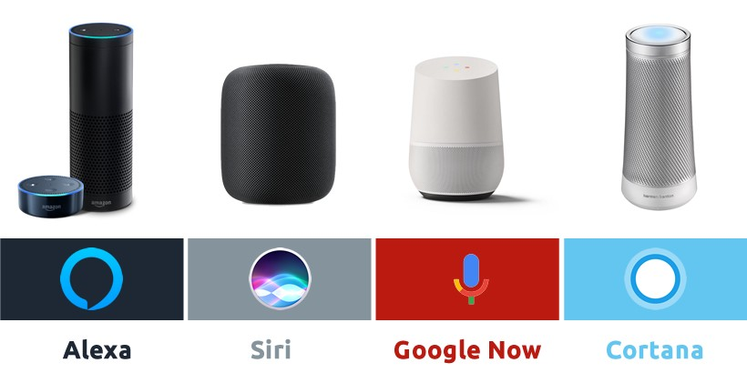
Examples and Applications
Virtual Personal Assistants
ML gives them voice recognition capabilities and helps them construct sentences to chat with the user.

Slide 10
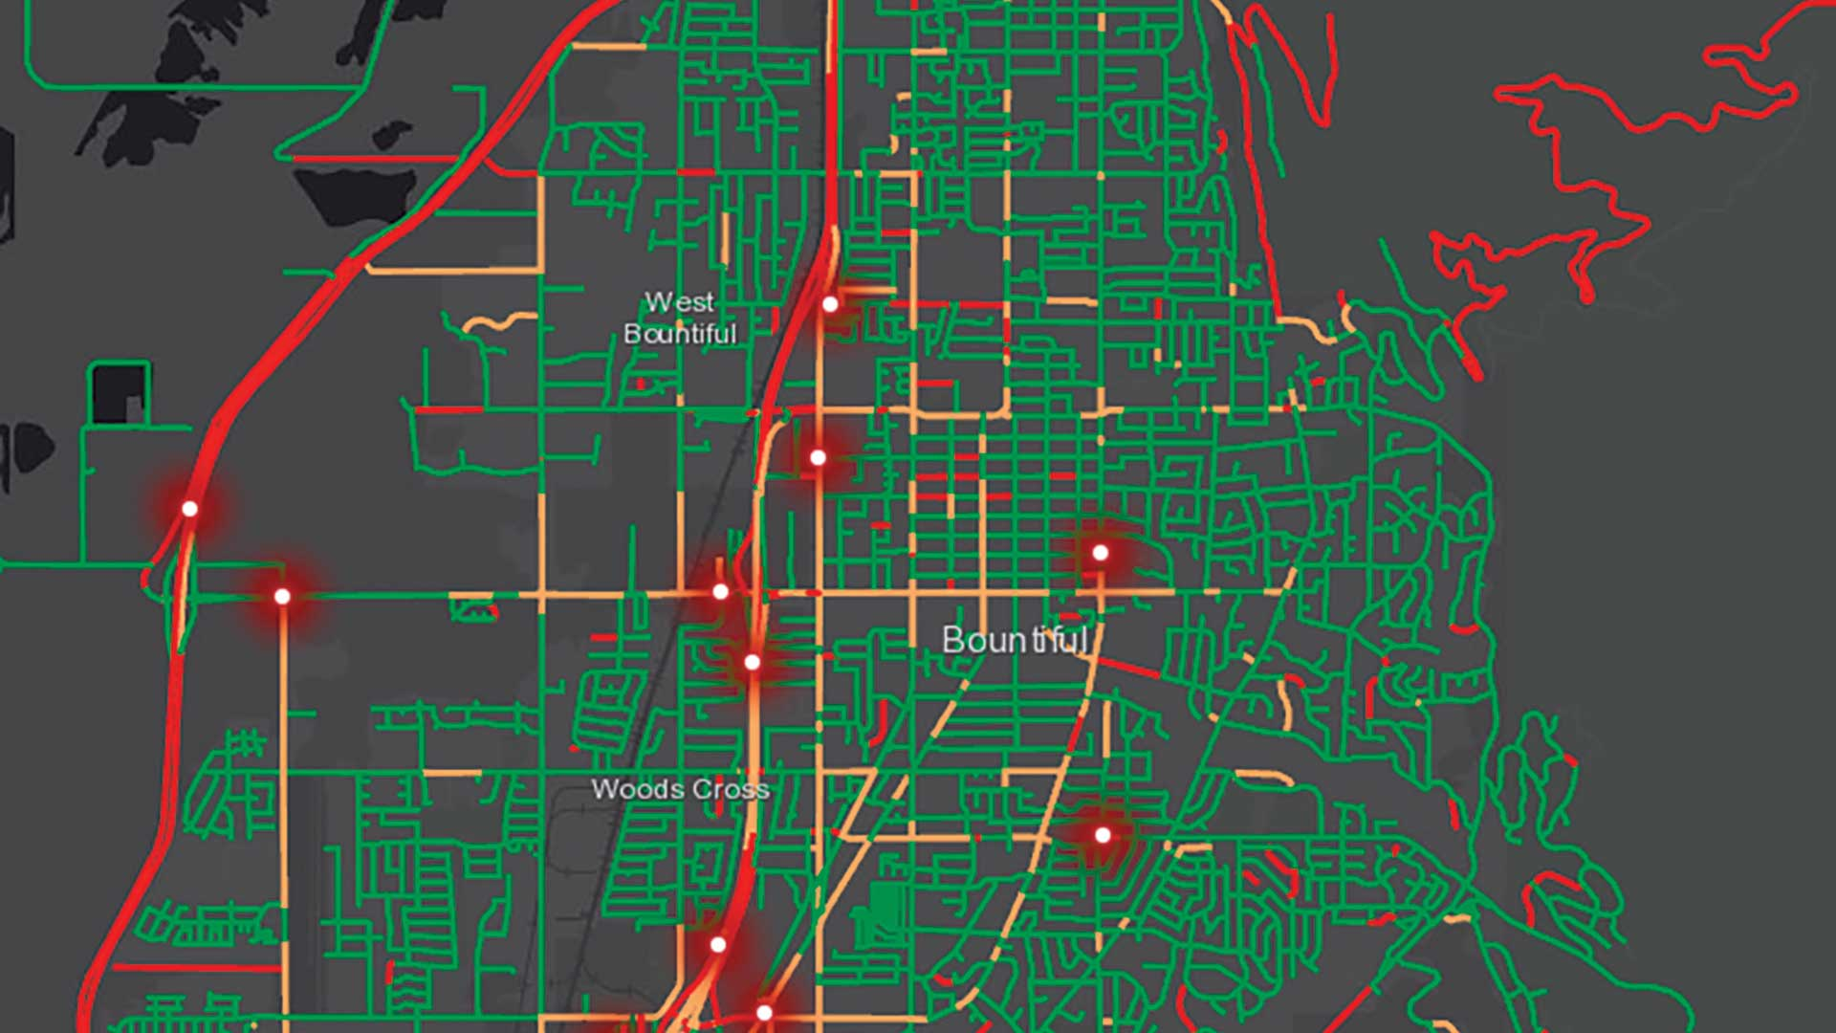
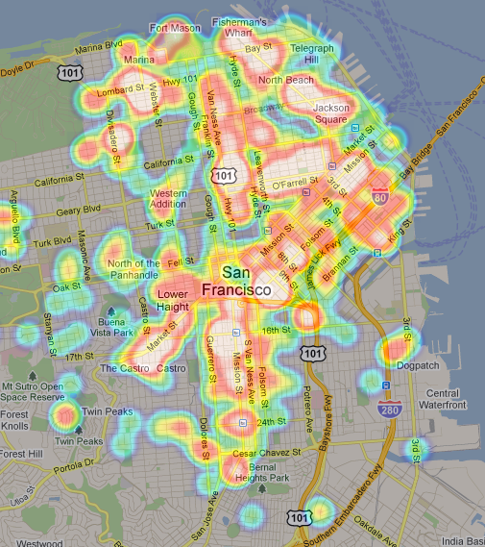
Examples and Applications
Predictions while Commuting
Traffic Predictions: ML helps to estimate the regions where congestion can be found on the basis of daily experiences.
Online Transportation Networks: The engineers at UBER use ML to define price surge hours by predicting the rider demand.

Slide 11
Introduction to Terminology in ML

Slide 12
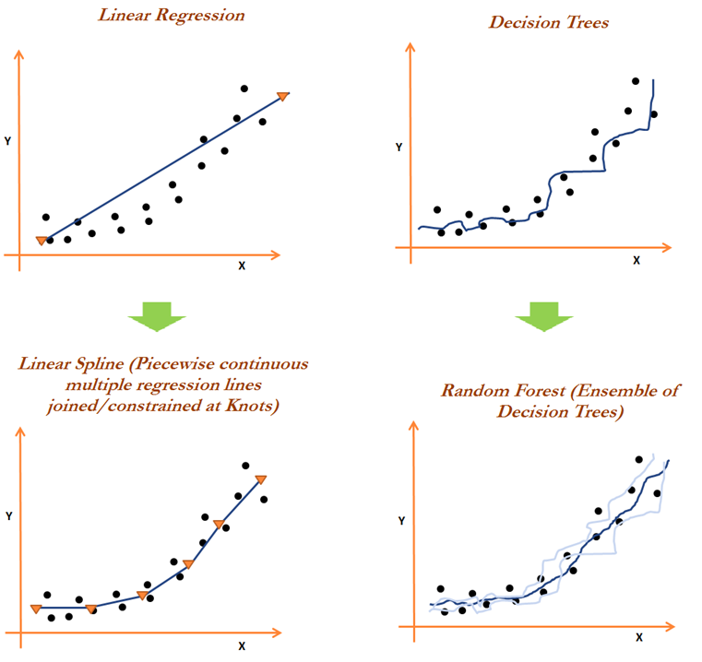
Terminology
An Algorithm is a set of rules that a machine follows to achieve a particular goal. An algorithm can be considered as a recipe that defines the inputs, the output and all the steps needed to get from the inputs to the output.
Examples of some algorithms:

Slide 13
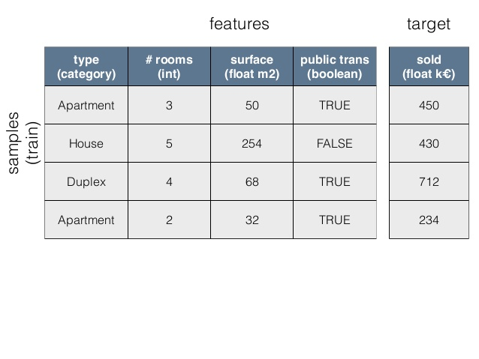
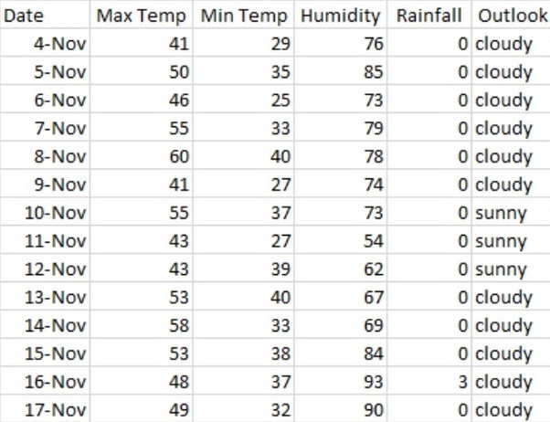
The Features are the inputs given to the model. A feature will look like a column in the dataset.
The Target is the information the machine learns to predict. In mathematical formulas, the target is usually called y(i) for a single instance.

Slide 14
Machine Learning Subtypes

Slide 15
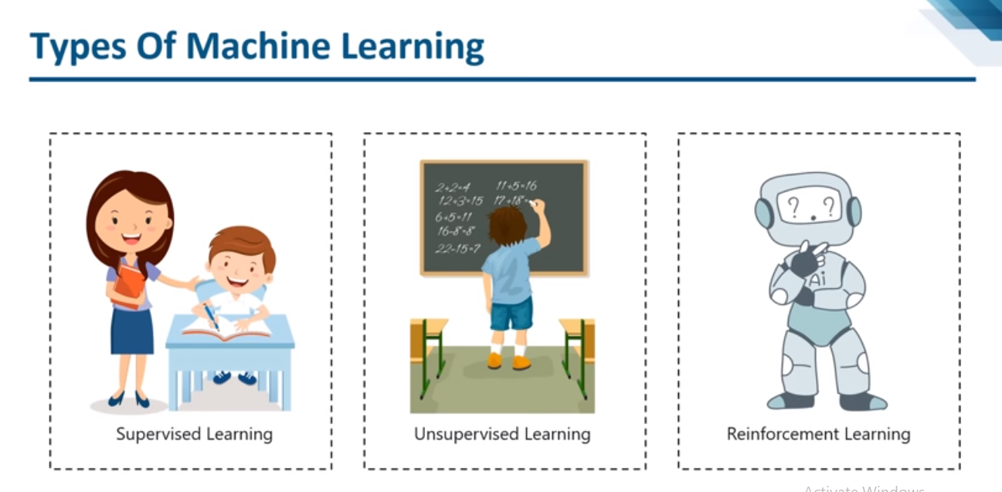
The Three Main Types
1) Supervised 2) Unsupervised 3) Reinforcement Learning

Slide 16
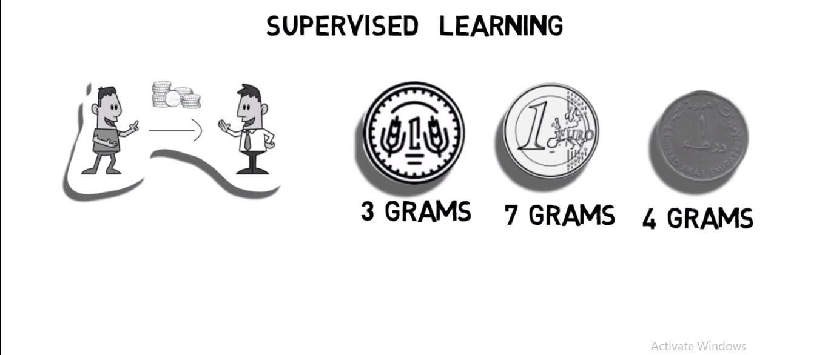
Supervised Learning: An Example
Suppose your friend gives you 100 coins of 3 different currencies.
Now he blindfolds you and asks you to guess which coin he gave you.

Slide 17
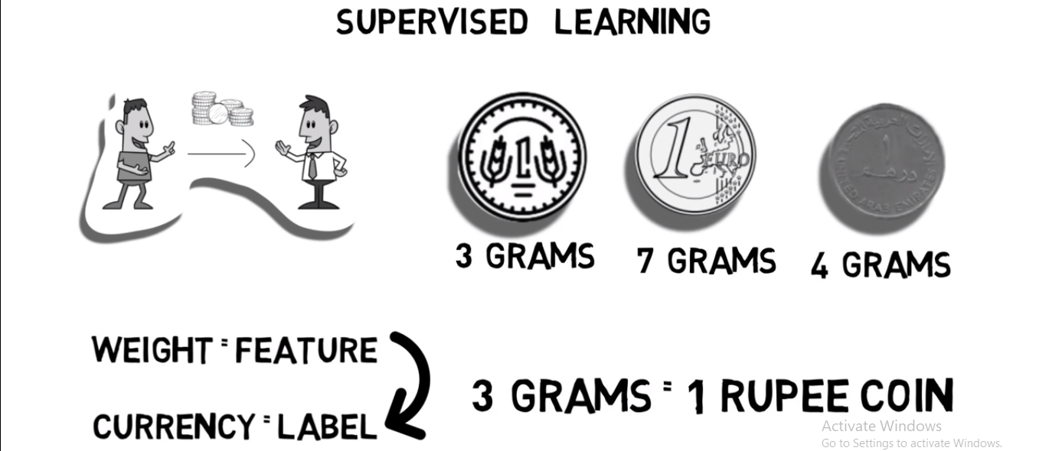
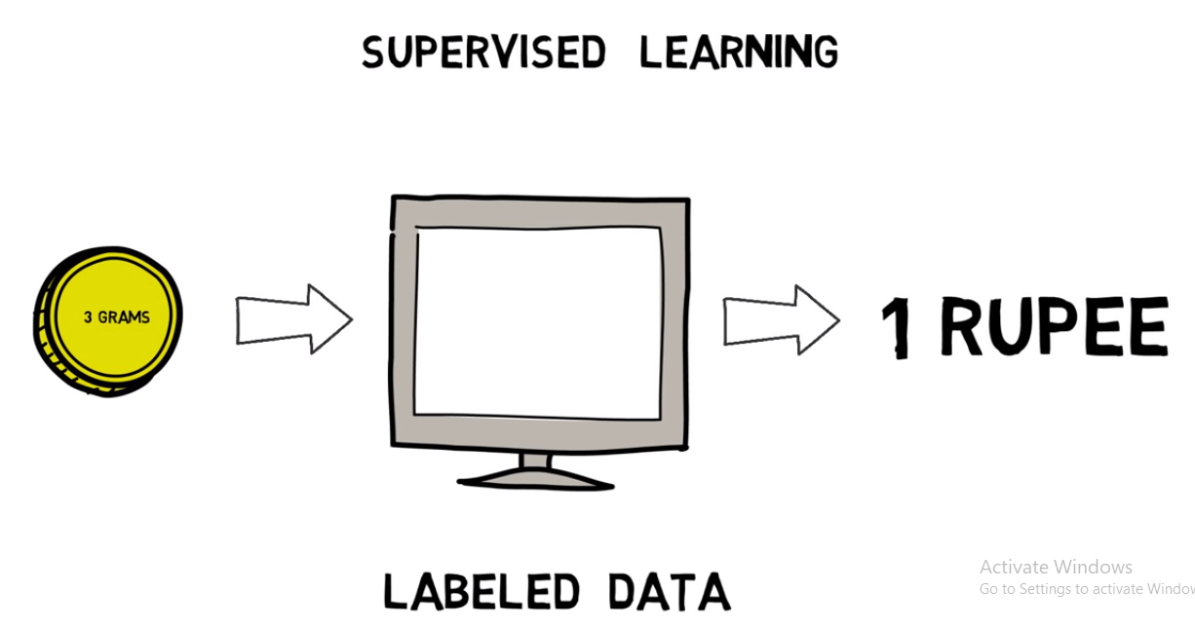
Your will learn to guess the currency of the coin based on its weight
Thus, the model here connects different weights with different labels or different currencies and studies how they are correlated.

Slide 18
Supervised Learning Key Points
Supervise - To oversee/direct an activity
Machine/Algorithms learn under guidance
By feeding them “LABELLED DATA”
Goal is to learn input – output mapping from data

Slide 19
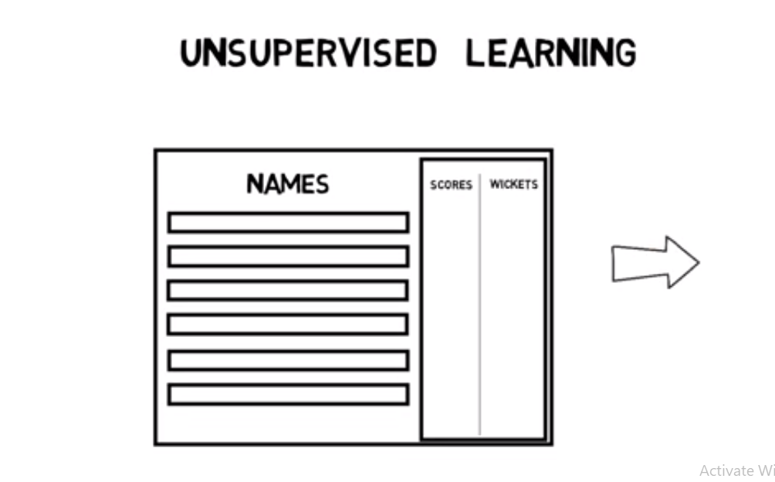
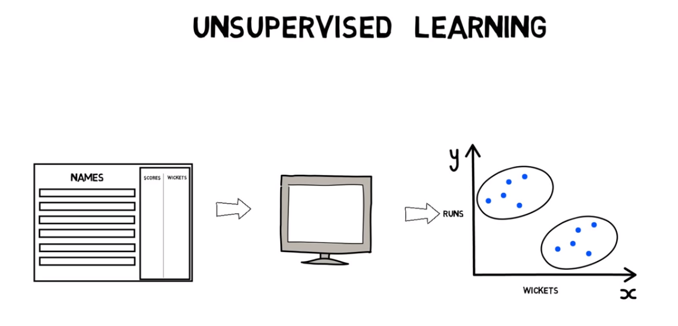
Unsupervised Learning: An Example
A Cricket dataset of various players with their respective scores and wickets taken. What all groups do you think can be created ?
Our model will identify patterns by grouping together similar cricketers

Slide 20
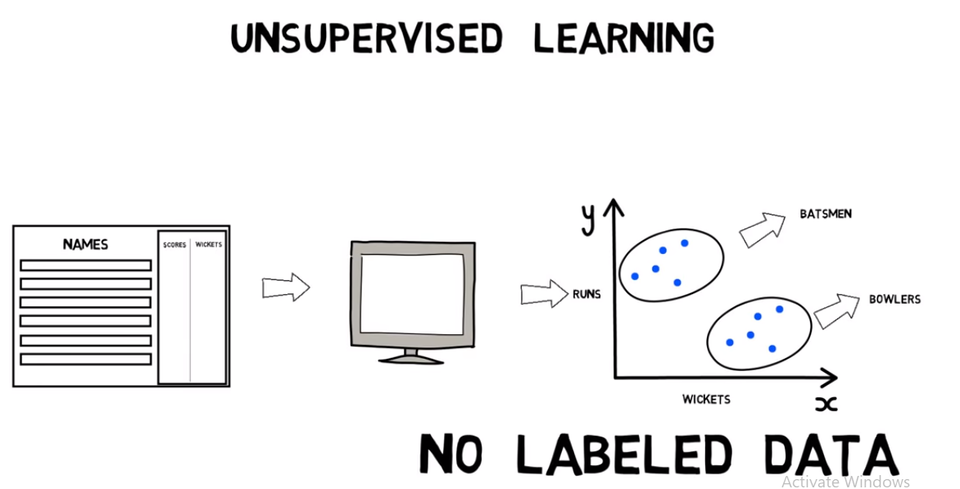
Initially, there were no labels for batsmen and bowlers but now, we can easily label them.

Slide 21
Unsupervised Learning Key Points
To act without supervision/direction
Model/Algorithm finds hidden patterns
No labelled data to guide
Goal is to create clusters or group together similar items

Slide 22
Supervised Learning Subtypes

Slide 23
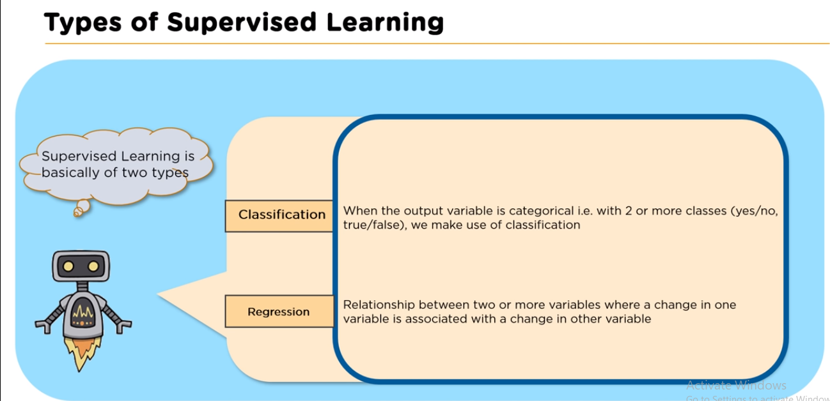
The Two Subtypes
1) Classification 2) Regression

Slide 24
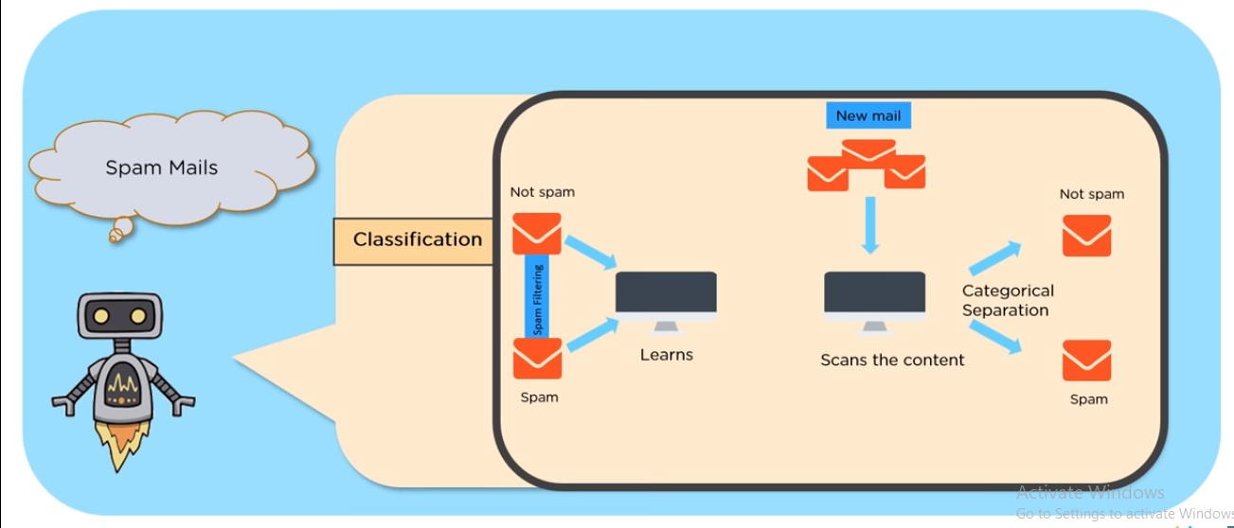
Classification Example
Classification is used when the target variable is discrete/ divided into
different classes.

Slide 25
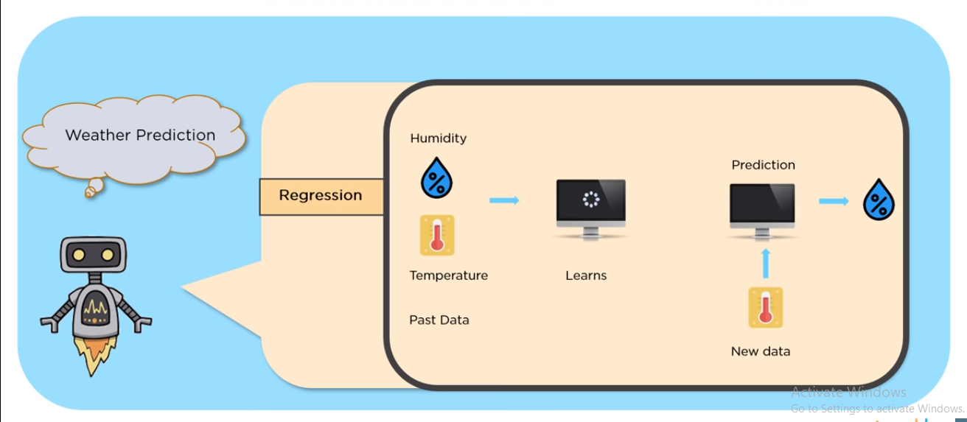
Regression Example
Regression is used when the target variable is continuous/when the target variable is defined over a range of values.

Slide 26
Workflow of a Machine Learning problem

Slide 27
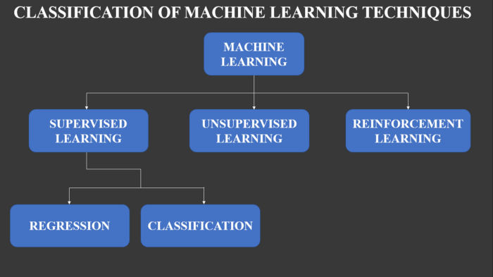
1. Problem Definition
Define your generic problem as a machine learning problem.
Choose between Supervised, Unsupervised and Reinforcement Learning.
Choose between the subtypes. Eg: Regression and Classification.

Slide 28
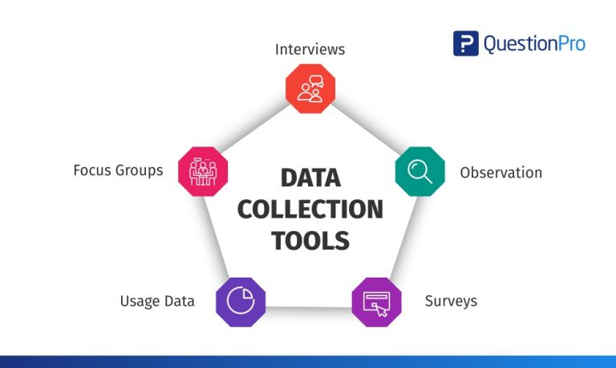
2. Data Collection
You cannot perform machine learning without having data.
Different ways of collecting data:
Taking a survey and collecting information first-hand
Collecting data by using an API
Using Web scraping to collect data
Downloading datasets from the web.
Eg: data.gov.in, Kaggle.com,
https://datasetsearch.research.google.com/ etc.

Slide 29
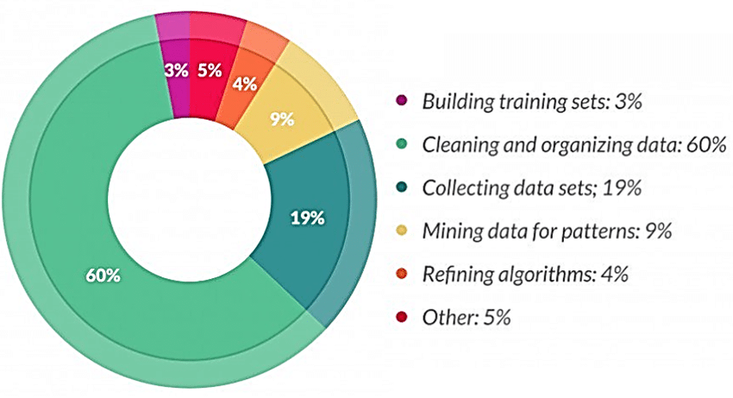
3. Data Pre-processing
The phrase "garbage in, garbage out" is particularly applicable to data mining and machine learning projects.
Most of the real-world data is messy, some of these types of data are:
Missing data
Outliers
Duplicate data

Slide 30
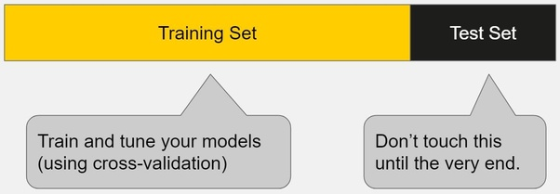
4. Splitting the Dataset
The order of this and the previous step varies from dataset to dataset.
We split the dataset into “Train”, “Validation” and “Test” sets.
Train set is used to learn how to differentiate between the examples.
Test set is used to check how good our algorithm performs on unseen data.

Slide 31
5. Training the Model
The model learns the parameters and learns the function we need it to.
We train multiple models, i.e, different algorithms on the same training set.
This is where the magic happens.

Slide 32
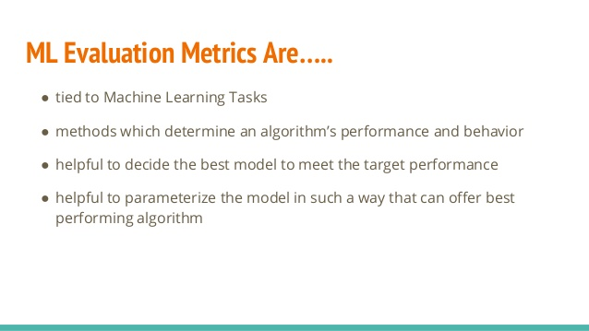
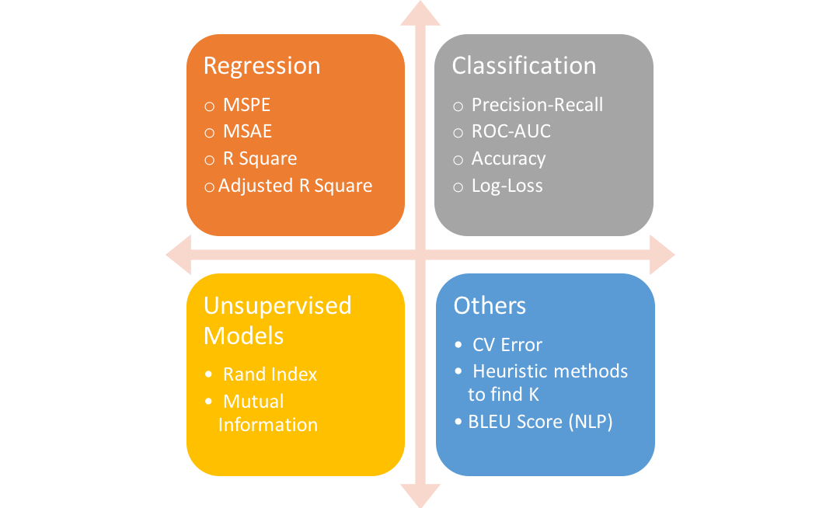
6. Evaluation/Testing
We run all models on the test set.
We compare them using some standard metrics.

Slide 33
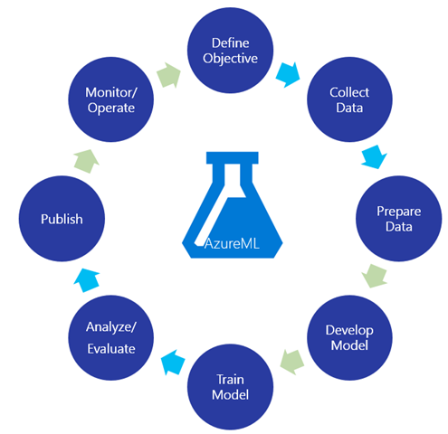

Slide 34
Train and Test Dataset

Slide 35
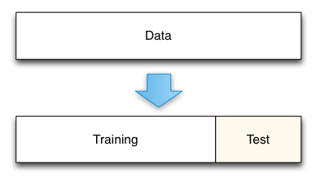
Why Two datasets ?
Can you take an exam without studying?
Can a cricketer directly go to the field without practicing on nets?

Slide 36
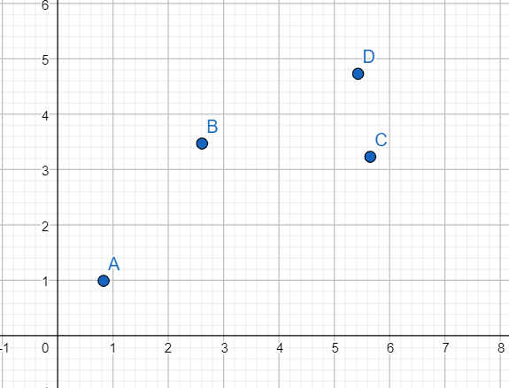
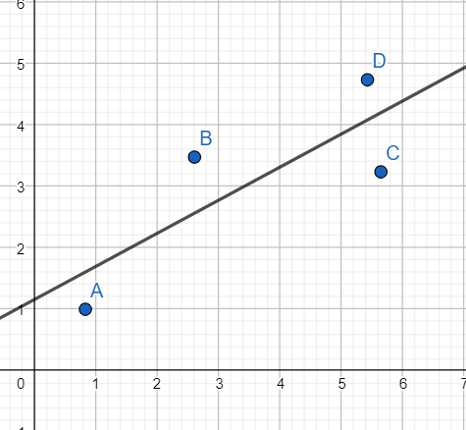
An Example

Slide 37
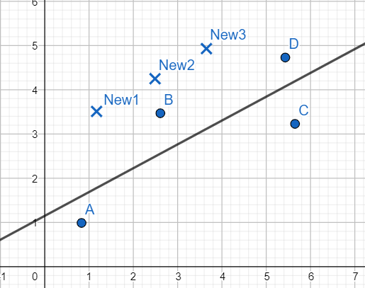
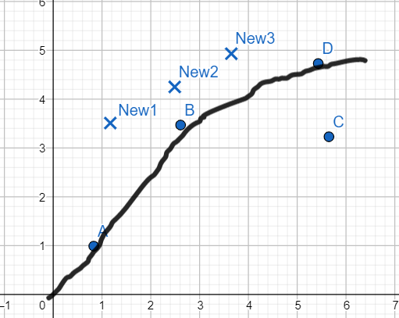
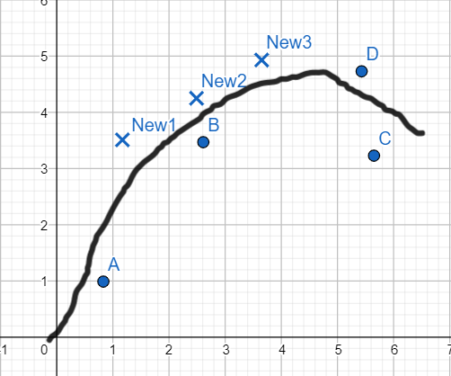
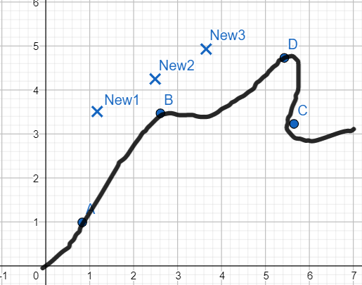

Slide 38
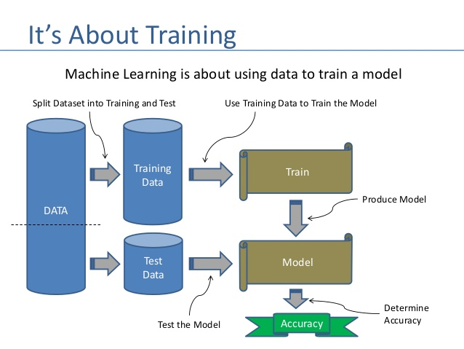
Use of train and test datasets
TRAIN DATASET
It is the dataset using which we prepare our model. This is the dataset using which the input output mapping is learnt.
TEST DATASET
It is the dataset using which we test the accuracy of our model to check how good our model is.

Slide 39
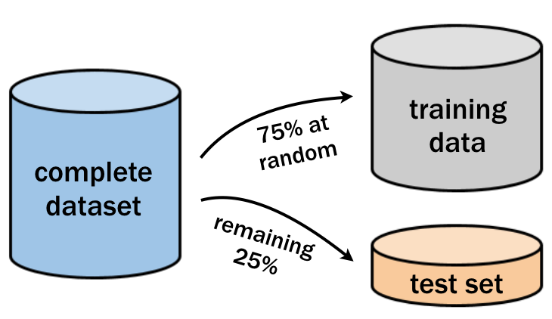
How to Divide the Data ?
Our main task is to create a good training model which can correctly predict the output in all cases. So we try to give the maximum data to training data.
Test data is just for checking if our model is good or not.

Slide 40
Introduction to a Regression Metric

Slide 41
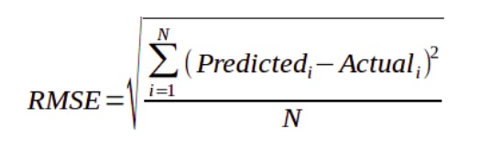
RMSE
RMSE stands for Root Mean Square Error.
The value of RMSE determines the accuracy of our models
RMSE is the under root of the mean of the squared errors.

Slide 42
RMSE
RMSE stands for Root Mean Square Error.
The value of RMSE determines the accuracy of our models
RMSE is the under root of the mean of the squared errors.

Slide 43
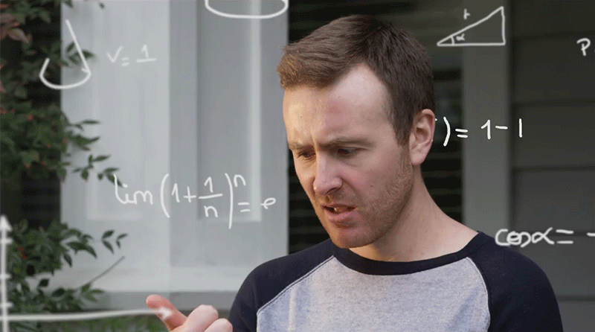
Confused?

Slide 44
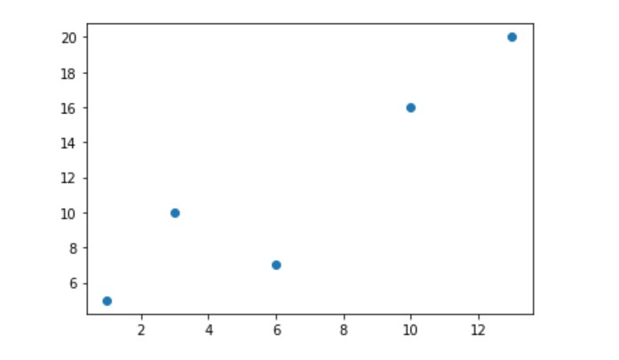
Lets graph our data points. These points depict the actual values of y(i) at different values of x(i).
We got you covered !

Slide 45
The star is the predicted value of y at x=6.
Error is the difference between the predicted value and actual value.
Error

Slide 46
RMSE Steps
1. Calculate Individual Errors 2. Square those errors 3. Calculate mean of those squares 4. Calculating the root of the above gives us RMSE

Slide 47
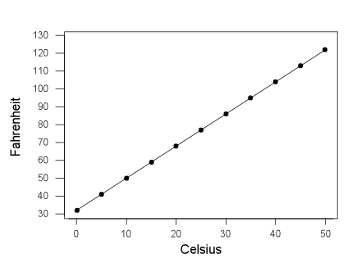
An Extreme Case
When all the predictions are correct
What will be the RMSE here ?
What do you think are the limits for RMSE ?

Slide 48
Practical Time

